Slide 1

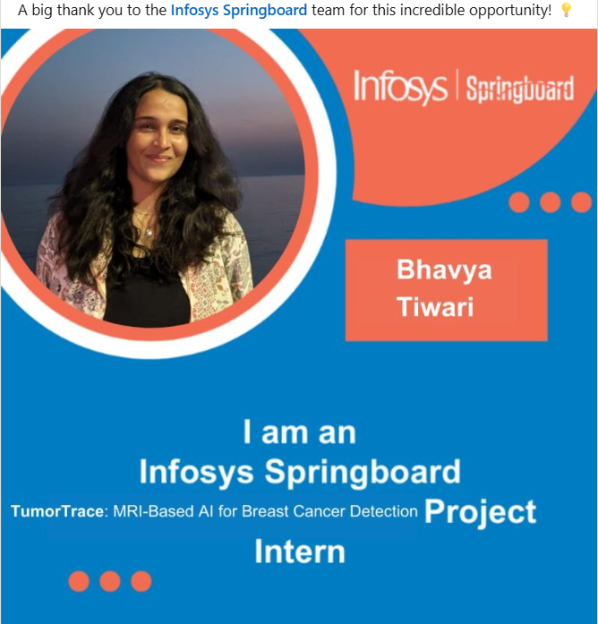
INFOSYS SPRINGBOARD AI PROJECT INTERNSHIP -- TumorTrace: MRI-based AI for Breast Cancer Detection
Presented by: Bhavya Tiwari
Mentor: Mr. Anurag Sista

Slide 2


01
Problem Statement
02
Data Preprocessing
03
Models Trained
CONTENTS
04
Output

Slide 3

PROBLEM STATEMENTS
Rising Prevalence of Breast Cancer: Breast cancer is one of the leading causes of cancer-related deaths worldwide, with early detection playing a crucial role in reducing mortality rates.
Challenges in Manual Diagnosis: Analyzing breast MRI scans is a time-intensive task prone to subjective interpretation, which may lead to misdiagnosis or delayed treatment.
Need for Automated Solutions: The complexity of breast tissue patterns in MRI images necessitates robust automated methods to assist radiologists in identifying malignant and benign cases accurately.
Leveraging Deep Learning Models: Advanced deep learning architectures like VGG-16, ResNet-18, and ResNet-50 have demonstrated exceptional capabilities in image classification, offering potential for precise tumor detection.

Slide 4
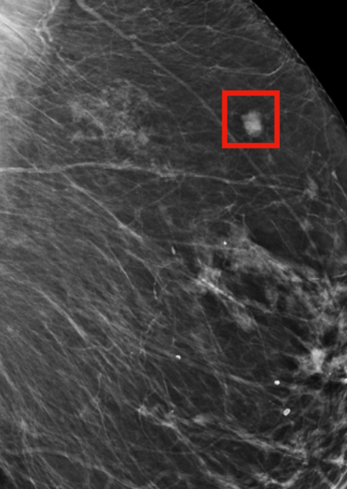
Limited Availability of Specialized Expertise: Access to skilled radiologists is often limited in underdeveloped or remote regions, creating a need for reliable automated diagnostic tools.
Data Complexity and Variability: MRI scan data exhibits high variability due to differences in patient anatomy, imaging protocols, and tumor characteristics, making it challenging to develop generalized and robust detection models.
Improving Diagnosis Accuracy: Utilizing state-of-the-art convolutional neural networks (CNNs) can enhance diagnostic accuracy, minimizing false positives and negatives in breast cancer detection.
Objective: To develop and evaluate a deep learning-based system using VGG-16, ResNet-18, and ResNet-50 for effective classification of breast MRI scans into malignant and benign categories.

Slide 5
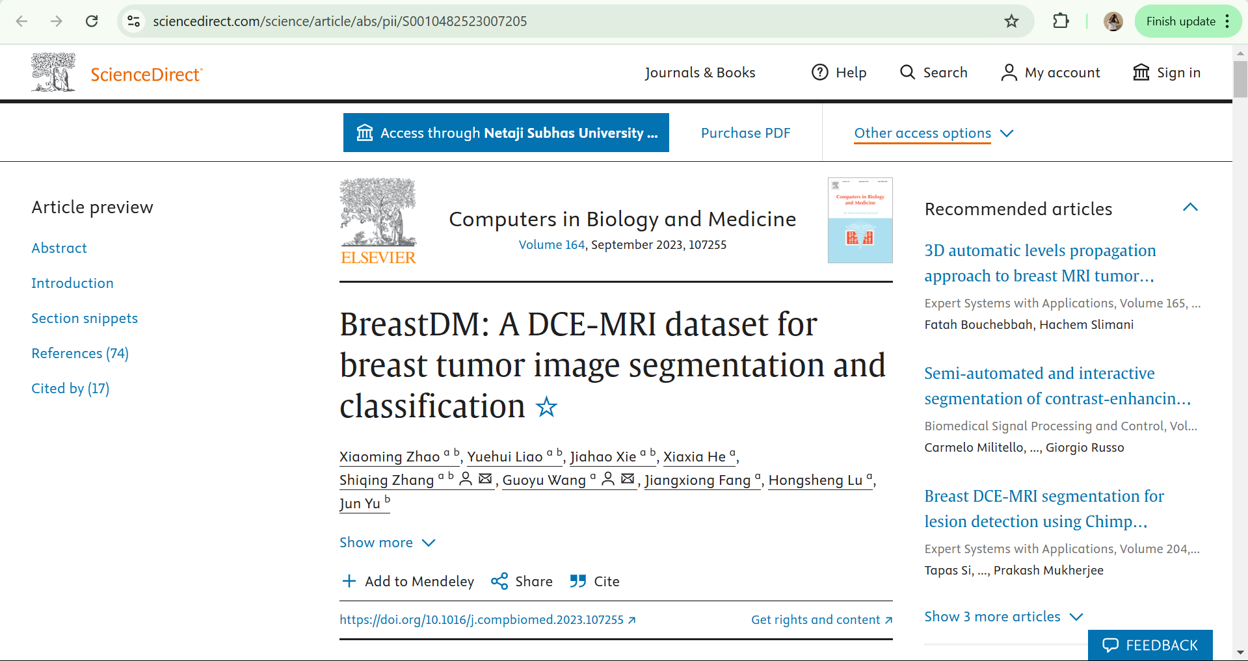
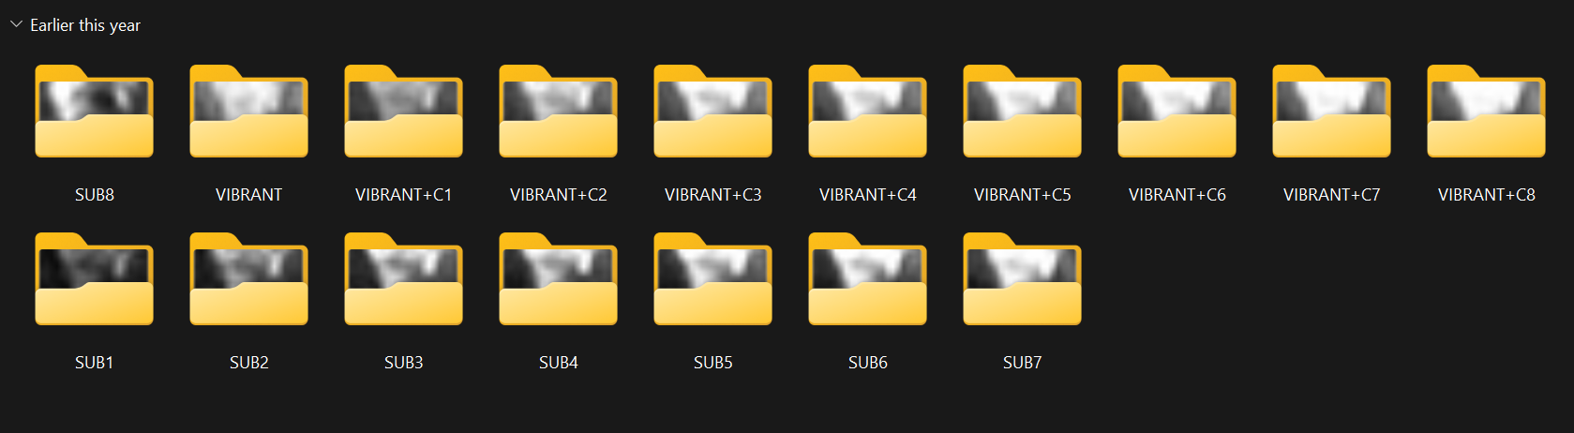
DATASET
The dataset used in this project consists of MRI breast cancer images, categorized into two labels: Benign and Malignant. The images are organized into three subsets: training, validation, and testing, to facilitate the development and evaluation of the classification model.
Source:
https://www.sciencedirect.com/science/article/abs/pii/S0010482523007205
Structure: Train Set: 20,434 images Validation Set: 1,989 images Test Set: 6,851 images
Image segmentation had been performed on all these images

Slide 6
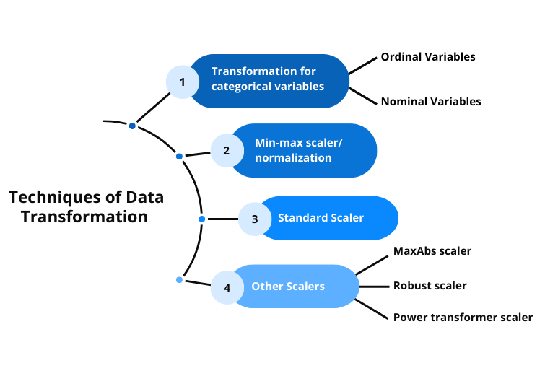
PREPROCESSING:
DATA TRANSFORMATION
Resizing
All images were resized to 224 × 224 pixels to match the input size required by the ResNet18 model.
Ensures uniformity across the dataset as MRI images vary in resolution and aspect ratio.
Normalization
Pixel values, originally ranging from 0 to 255, were scaled to a range of 0 to 1 by dividing by 255.
This step adjusts the data distribution to match the pre-trained model's expected input format

Slide 7
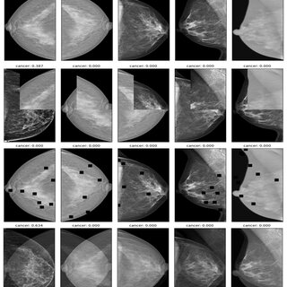
DATA AUGMENTATION
Random Horizontal Flip: Flips the image horizontally with a probability.
Random Rotation: Rotates the image by a random angle.
Random Resized Crop: Crops and resizes a random portion of the image.
Color Jitter: Adjusts brightness, contrast, saturation, and hue randomly.
Conversion to Tensor: Converts the image into a tensor format for model input.

Slide 8

FEATURE EXTRACTION
1. Histogram of Oriented Gradients (HOG)
Highlights edge directions and intensity gradients to outline objects.
2. Sobel Operator
Calculates gradient magnitude and direction to emphasize image edges.
3. Gray-Level Co-Occurrence Matrix (GLCM)
Analyzes spatial relationships between pixel intensities in grayscale images.
4. Local Binary Pattern (LBP)
Captures texture by comparing each pixel’s intensity with its neighbors.
5. Multi-Variance Median LBP (MVM-LBP)
Extracts intricate texture patterns for fine-grained tumor features.

Slide 9
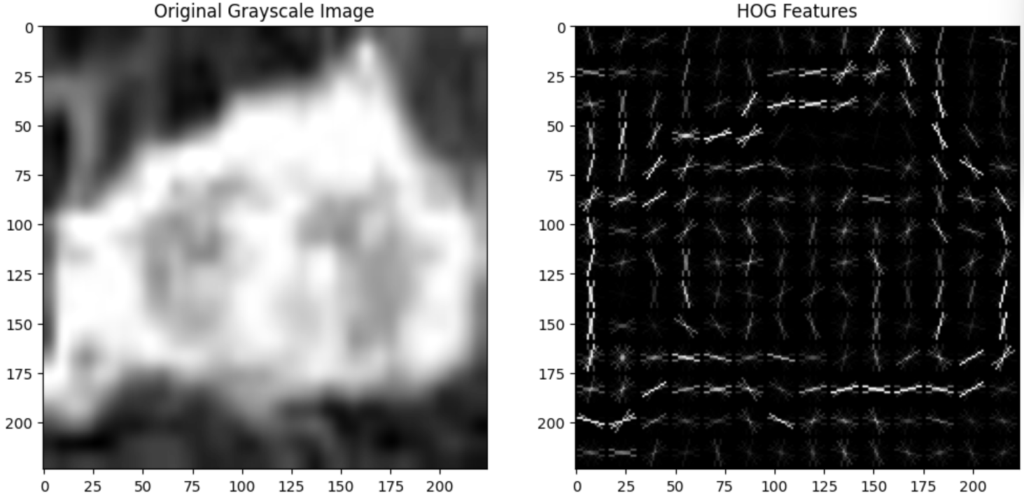
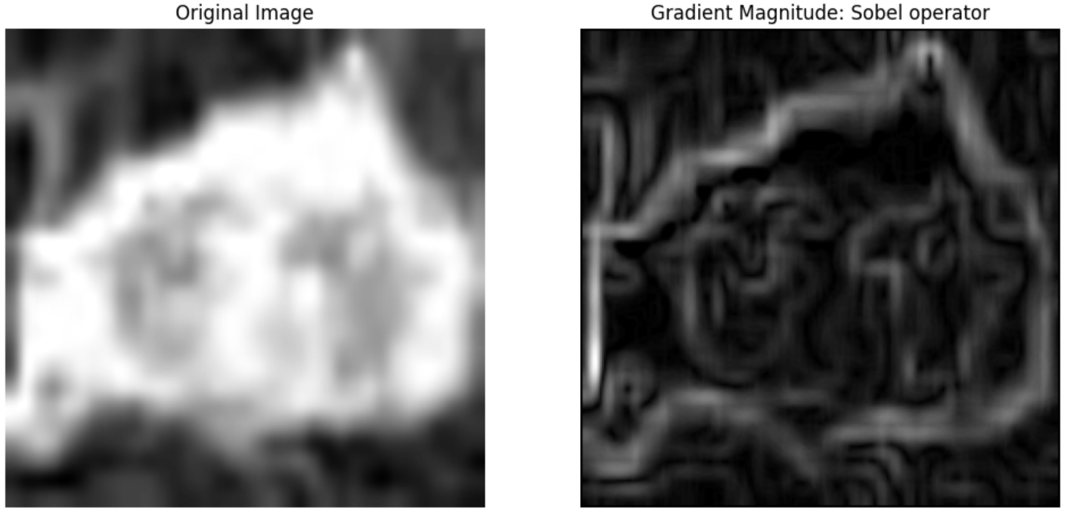

Slide 10
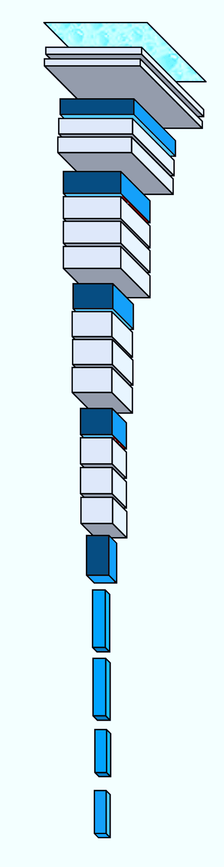
MODELS USED
1. VGG-16
A deep CNN with 16 layers.
Known for simplicity and uniform architecture with 3x3 convolutional filters.
Effective for image classification but computationally heavy.
2. ResNet-18
A lightweight residual network with 18 layers.
Introduces skip connections to avoid vanishing gradients.
Balances accuracy and computational efficiency.
3. ResNet-50
A deeper residual network with 50 layers.
Uses bottleneck blocks for efficient training of deeper models.
High accuracy for complex image recognition tasks.

Slide 11
EVALUATION METRICS FOR CLASSIFICATION MODELS
Accuracy: Percentage of correct predictions overall.
Precision: Measures the model's ability to minimize false positives.
Recall (Sensitivity): Indicates how well the model identifies actual positive cases.
F1 Score: Harmonic mean of precision and recall; balances the two metrics.
AUC (Area Under the Curve): Assesses the model's ability to differentiate between benign and malignant tumors.
Confusion Matrix: Displays true positives, true negatives, false positives, and false negatives to analyze model performance.

Slide 12
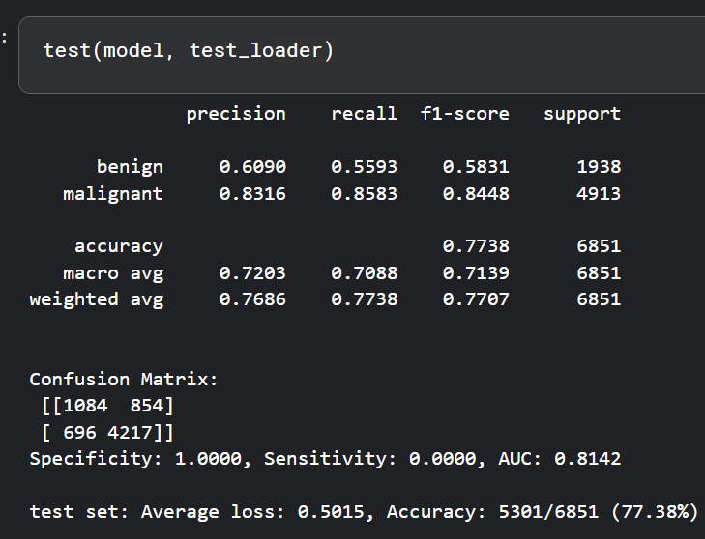
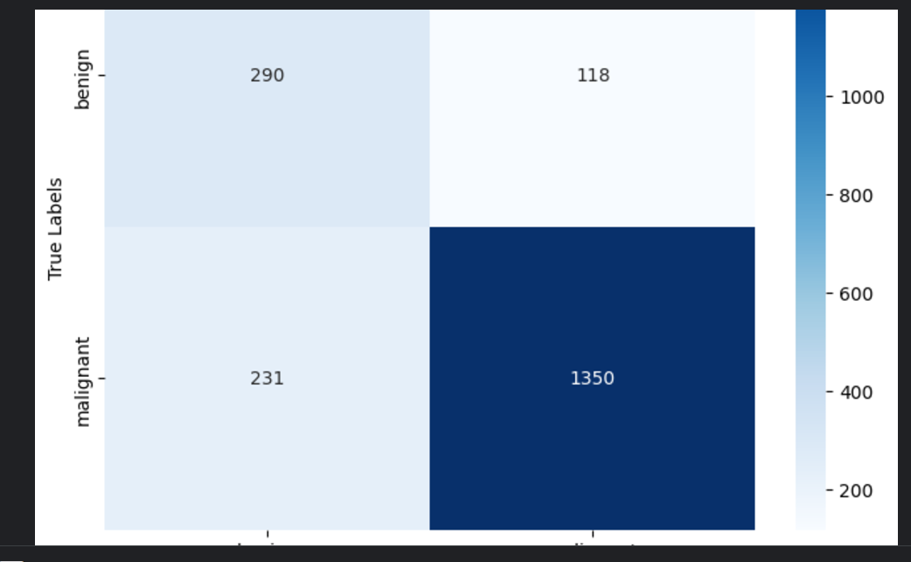
OUTPUT: VGG-16
Training Accuracy: 85.22%
Average Loss: 0.3613
Validation Accuracy: 82.55%
AUC: 0.9178
Test Results:
Average Loss: 0.5015
Accuracy: 77.38% (5301/6851)

Slide 13
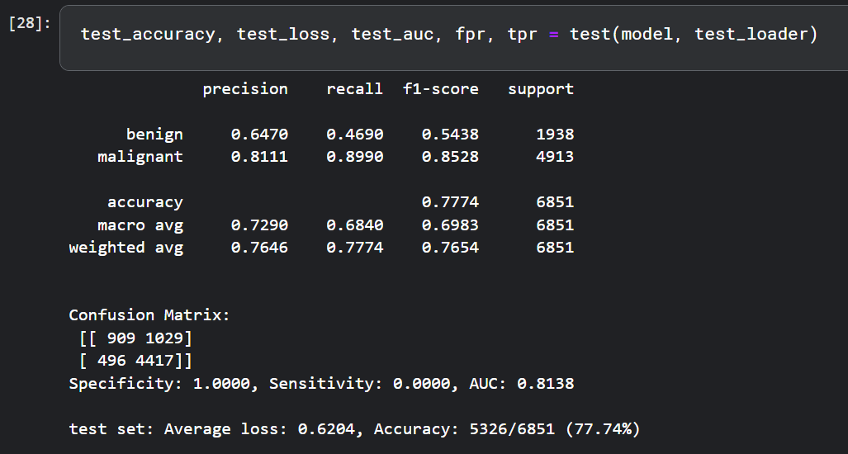
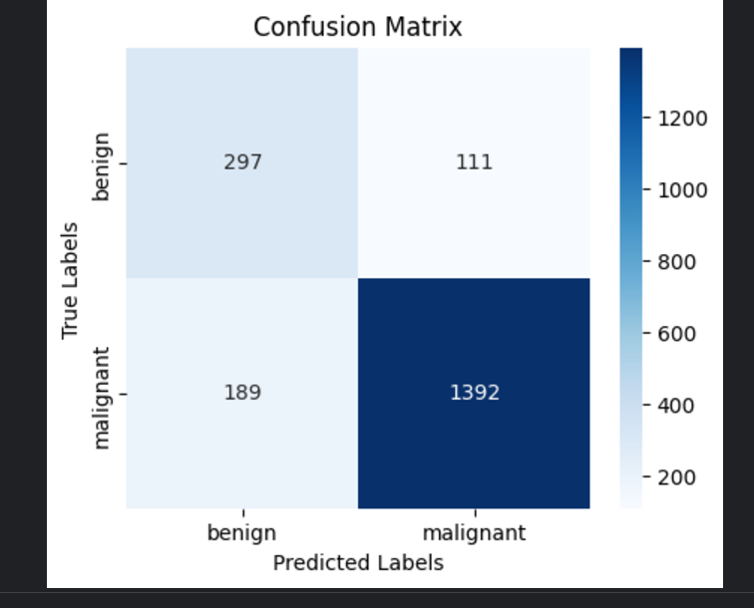
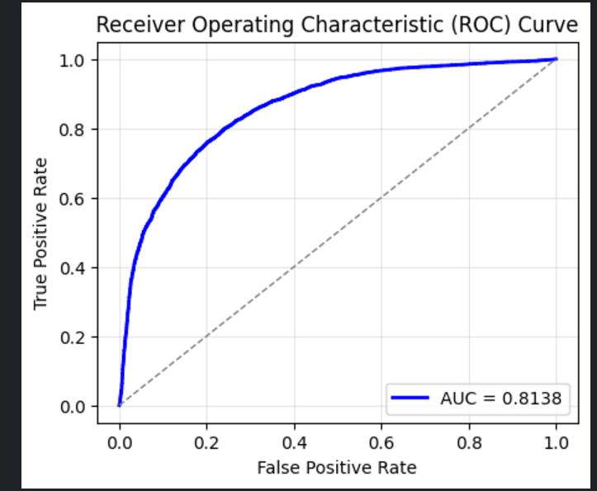
OUTPUT: ResNet-18
Training Accuracy: 97.86% Average Loss: 0.3862 Validation Accuracy: 84.92% AUC: 0.9324
Test Results: Average Loss: 0.6204 Accuracy: 77.74% (5326/6851)

Slide 14
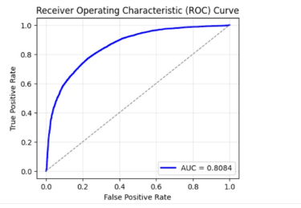
OUTPUT: ResNet-50
Training Accuracy: 93.69% Average Loss: 0.3713 Validation Accuracy: 84.44% AUC: 0.9235
Test Results: Average Loss: 0.3862
AUC: 0.8084 Accuracy: 84.92% (5326/6851)

Slide 15
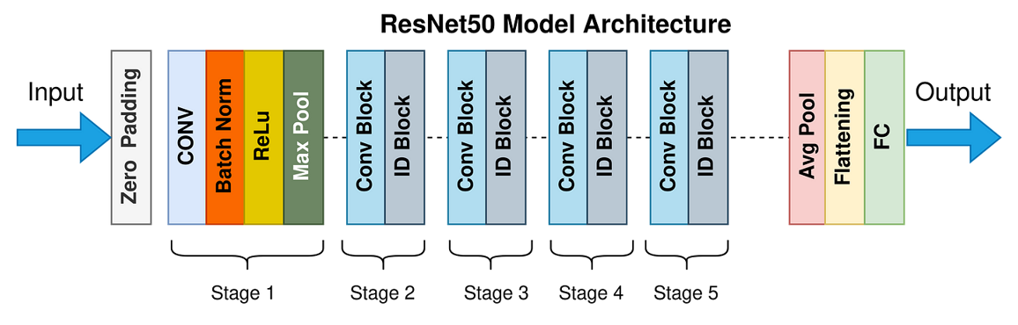
CONCLUSION
Best Model: ResNet-50
Reason:
Highest Test Accuracy (84.92%)
Lowest Test Loss (0.3862)
Balanced Performance across training, validation, and testing phases.
Superior AUC of 0.9235, indicating strong capability in distinguishing between benign and malignant tumours.

Slide 16
DEMO
Gradio-based Application

Slide 17
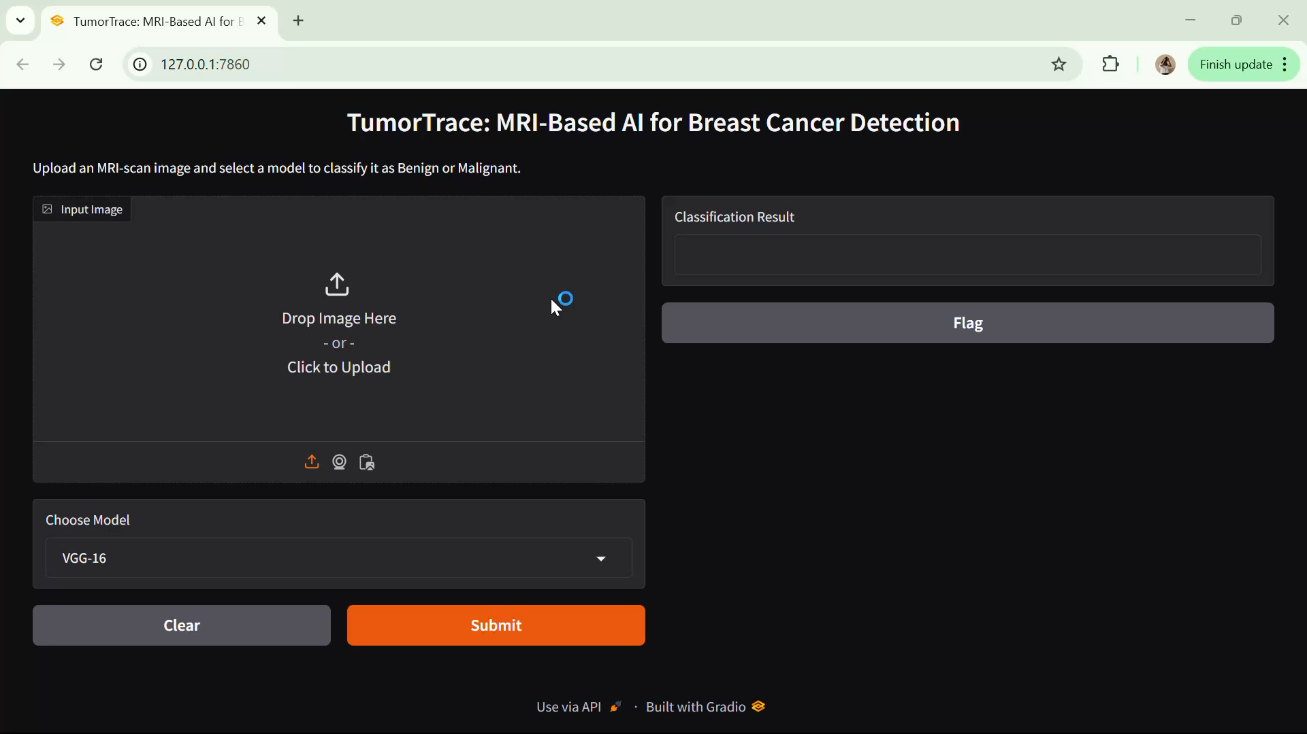

Slide 18


